Slide 1
ITP211 Object-oriented Analysis and Design and Project
Use Case Models &
Use Case Descriptions

Slide 2

Learning Outcomes
To be able to:
explain the purpose of developing models
identify components in a use case diagram
construct a use case model
describe main flow and alternative flows (scenarios ) for a use case using a use case description.

Slide 3

Models and Modeling
What are Models?
Is a simplified representation to describe some selected aspects of the system being built.
Purpose of Modeling
Models can be used to document different parts of a problem and/or solution during software development.
Analyst uses different types of models to show different levels of system details.
View the same problem from different perspectives for new requirements discovery.
Models are communication tools among stakeholders of a project.
Eg. Use case diagram, use case description, class diagrams.
Notes:
A representation of a system that allows for investigation of the properties of the system
A model is any simplification, substitute or stand-in for what you are actually studying or trying to predict.

Slide 4
Advantages of using models
Manage complexity of system to essential components.
As a visual cue to convey information to users and get feedback.
Allow analysts to clarify and refine requirements early in the development.
Provides a way to store information as documentation for later use and reference.
Serve as a platform for effective teamwork amongst project team members.
Promotes understanding.

Slide 5

UML
Unified Modeling Language
Not a programming language like C++, C# or Java
UML is a pictorial language used to make software blue prints.
A standardized, general-purpose visual modeling “language” used in software engineering to visualize, specify, construct and document software system.
Includes a set of graphic notation techniques to create visual models of object-oriented software systems.
Notes:
Unified Modeling Language (UML) is a standardized, general-purpose modeling language in the field of software engineering. The Unified Modeling Language includes a set of graphic notation techniques to create visual models of object-oriented software-intensive systems.
The Unified Modeling Language was developed by Grady Booch, Ivar Jacobson and James Rumbaugh at Rational Software in the 1990s.[1] It was adopted by the Object Management Group (OMG) in 1997, and has been managed by this organisation ever since. In 2000 the Unified Modeling Language was accepted by the International Organization for Standardization (ISO) as industry standard for modeling software-intensive systems. The current version of the UML is 2.4.1 published by the OMG in August of 2011.
UML is a standard language for specifying, visualizing, constructing, and documenting the artifacts of software systems.
UML was created by Object Management Group (OMG) and UML 1.0 specification draft was proposed to the OMG in January 1997.
OMG is continuously putting effort to make a truly industry standard.
UML stands for Unified Modeling Language.
UML is different from the other common programming languages like C++, Java, COBOL etc.
UML is a pictorial language used to make software blue prints.
So UML can be described as a general purpose visual modeling language to visualize, specify, construct and document software system. Although UML is generally used to model software systems but it is not limited within this boundary. It is also used to model non software systems as well like process flow in a manufacturing unit etc.
UML is not a programming language but tools can be used to generate code in various languages using UML diagrams. UML has a direct relation with object oriented analysis and design. After some standardization UML is become an OMG (Object Management Group) standard.

Slide 6
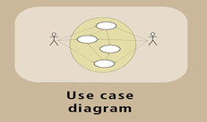
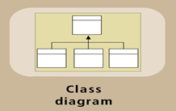
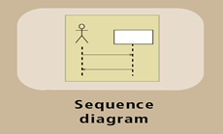
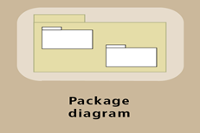
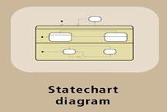
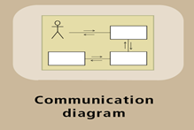
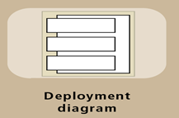
UML Diagrams used for Modeling

Slide 7
UML Use Case Diagram
Provides an overview of the requirements for a system.
Focus in the functional requirements of system used by users.
Components of a Use case diagrams:
Use cases
Actors
Associations
System boundary

Slide 8
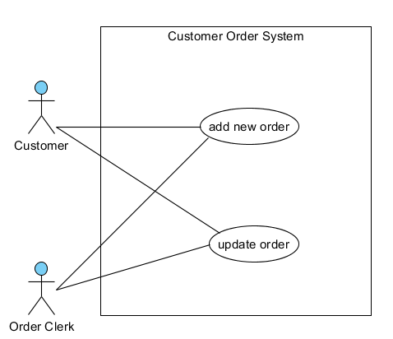
A Use Case Diagram for an Order System
System Name
Actor
System Boundary
Use Case
Association/Relationship
Actor
Use Case

Slide 9
Components of a Use Case Diagram
Use cases name
describes a goal (system function) that the user wants to achieve by using the system.
Actors
a person, organization, or external system that directly (or indirectly) interacts with the system with a specific role.
Associations
shows interactions between use cases and actors.
Notes:
An association exists whenever an actor is involved with an interaction described by a use case. Associations are modeled as lines connecting use cases and actors to one another, with an optional arrowhead on one end of the line. The arrowhead is often used to indicating the direction of the initial invocation of the relationship or to indicate the primary actor within the use case.
Notation for use case diagrams
Simple stick figure represents an Actor
Use case itself symbolized by an oval
Connecting lines match actors to use cases
Identifying actors at the right level of detail
Actors can be people and even non-human types such as devices or other systems
Directly interacting with system

Slide 10
Identifying Actors
Actor
Person or thing that interacts with the system.
Primary actor – initiates or triggers the use cases to achieve the actor’s goals.
Secondary actors – participates in the use cases to assist in the completion of a use case.
Normally described by nouns.
Example: A online bookstore system allows customer to buy books and payment is handled by an external payment system (e.g. Paypal or eNets).
Customer – Primary actor
External payment system – Secondary actors
Notes:
An actor specifies a role played by a user or any other system that interacts with the subject.
Primary Actor: The primary actor of a use case is the stakeholder that calls on the system to deliver one of its services. It has a goal with respect to the system – one that can be satisfied by its operation. The primary actor is often, but not always, the actor who triggers the use case.
Secondary Actors: Actors that the system needs assistance from to achieve the primary actor’s goal. It might be a high-speed printer, a web service, or humans that have to do some research and get back to us.

Slide 11
Identifying Use Case
Use Case
Something that the actors wants the system to do in order to achieve a goal.
Always triggered by primary actor(s)
Identified from the point of view of the actor
Actions phrases or verbs
Eg: A online bookstore allows customer to buy books and payment is done through an external payment system (e.g. Paypal or eNets).
Use Case Name: use a short verb phrase
E.g. Add orders, Cancel membership, Print reports

Slide 12

Developing a Use Case Diagram
Developing Use Case is an Iterative process:
[1] Identify the actors and roles.
[2] Identify the functions offered by the system.
[3] For each actor map the relationship to functions
*Sometimes you will uncover new system capabilities
[4] If required, map the relationship to the use case with the secondary actor. ( actor needed to support the use case but do not trigger the use case )
*Sometimes you will uncover new actors
[5] Iteratively refine the model till it stabilizes.

Slide 13

Identifying Actors
Perform a Textual Analysis to Identify Actors and Use Cases
Hints to identify Actors:
Looks for nouns that indicates:
Who will use the system?
Who needs the system to support daily work?
Who will maintain, administrate and operate the system?
Will it interact with other systems?
What is the scope of the system?
If functions are outside of the scope do I include
them?

Slide 14
Identifying Use Cases
Hints to identify Use Case:
Looks for verbs describing the following:
What function does the actor wants the system to perform.
What goals or intentions does the actor wants the system to achieve.

Slide 15
Use Case Description

Slide 16
Use case description
Use case diagram is a model suitable for non-technical people to appreciate the functions of the proposed system in a holistic manner.
When we need to develop the system, some extra details would be needed to handle details such as what to do when user cannot remember the login password. So we use another model to manage these details.
We need “Use case description” to specify/define the many possible situations ( scenarios ) that the system is expected to handle.

Slide 17
Use Case Descriptions
Use cases have internal complexity:
Sequence of steps to execute business process to achieve the user’s goal
Several variations may exist within single use case - eg: “place order” steps varies : is it customer a registered member entitled to privileges?
Each variation is called a scenario
Represents a possible situation that may arise
Important to identify all possible scenarios
Good system must take care of all identified scenarios
Should we take care of every possible scenarios?

Slide 18

Use Case Descriptions
Each use case is accompanied with a detailed use case description
Use Case Diagram
Use Case Descriptions
-Main flows
-Exceptions
Requirements Gathered

Slide 19
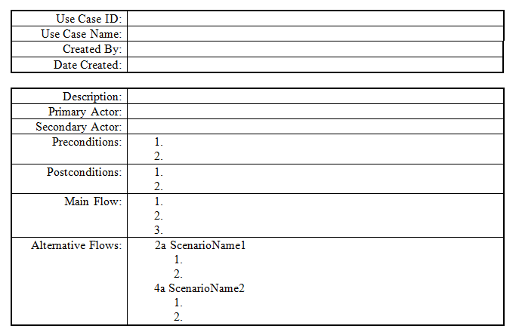
Use Case Description Template
Notes:
This is a typical use case description template but we will focus on main flow and alternative in this module.

Slide 20
Use Case Description Components
Primary Actor
Actors that triggers/initiates the use case (initiator)
Secondary Actor
Actors that interact with the use case after it is triggered (participator)
Main flow
List the user actions and system responses that will take place during execution of the use case under normal, expected conditions.
The sequence of actions and responses will ultimately lead to accomplishing the goal stated in the use case name and description

Slide 21
Use Case Description Components
Alternative flows
Document other, legitimate usage scenarios that can take place within the use case
Each flow should be preceded with a scenario name
List the user actions and system responses for the alternate scenario

Slide 22
Guidelines for use case description
UML does not provide standard rules for writing detail use case descriptions
There are guidelines that one can adhere to
Use Simple Grammar, eg:
Librarian enters book ID
System displays book details
Show clearly who is in control at point in time
Always start with:
The actor …. (replace actor with the actor’s name in the use case)
The system …

Slide 23
Guidelines for use case description
Eg:
The customer enters quantity to purchase
The system adds items into order list
Do not impose constraints on user interface
User clicks on OK button to submit personal details
User submits personal details to system
User Input1 (by entering data):
The actor enters ….
The actor submits …
The system validates ….
The system verifies …



Slide 24
Guidelines for use case description
User Input2 (by selecting data):
The system retrieves list of …
The system displays list of …
The actor selects …
The actor submits ….
The system validates ….
System responses:
The system computes …
The system prints …
The system triggers …
The system :-
inserts, creates, updates, deletes

Slide 25
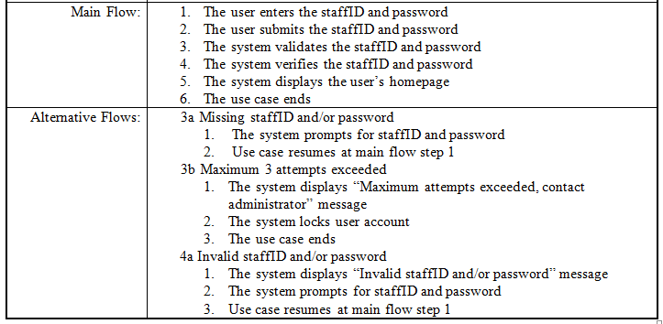
Use Case Description Example - login

Slide 26
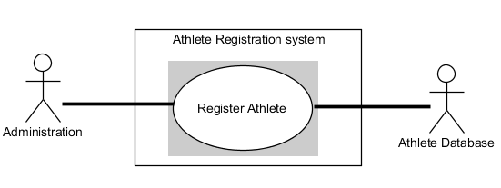
Use case description example
Requirements gathered:
A use case is used by the athlete/official administrator to register the athlete / official. The user has to key in the personal information such as name, date of birth, gender, address, country, passport number, type of participation and contact. Passport number and contact must be only in numbers.

Slide 27
Use case description – First attempt
Use Case Name: Register Athletes
Actor: Administrator
Basic flow:
Administrator Choose Create
Administrator Key in information
The System validates the information entered.
The System check for duplicate record from the data base.
System Creates the Athletes record successfully.
Alternate flow
3.1) Error message displayed. The system prompts Administrator to key in the information correctly.
4.1) Error message displayed. The System prompts Administrator that there is an Athlete with the same information.

Slide 28
Use case description example (improved)
Basic Flow:
Administrator selects create athlete record option.
System prompts administrator for details .
Administrator enters athlete/official’s details and submits.
System validates user personal details
System verifies the passport number for duplicate records.
System displays personal details, and prompts for confirmation.
Administrator confirms details entered.
System saves the personal details of the athlete/official in DB.
System displays success message.
Alternate Flows:
4A. Invalid personal details. Prompt user to re-enter.
5A. Duplicated records detected. Prompt user to re-enter.
8A. Record is not saved successfully.

Slide 29
Summary
Different UML models are used to model business events and objects.
Models are used to document system requirements
Use case diagram is used to model functional requirements for users to appreciate what the system can do. Ie the Goal the user wants the system to achieve.
Use case description is used to supplement a use case by defining the main flow ( steps to achieve the goals ) and alternate flows ( exceptions) that the use case is expected to handle.

